Slide 1
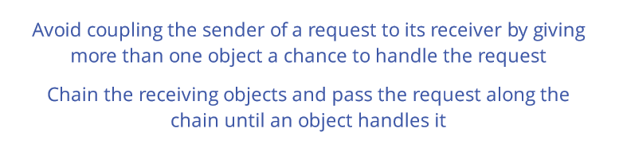
Chain of Responsibility
Intent

Slide 2
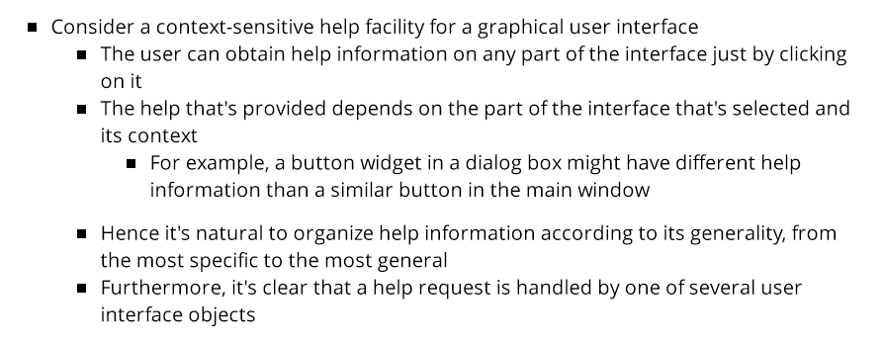
Chain of Responsibility
Motivation

Slide 3
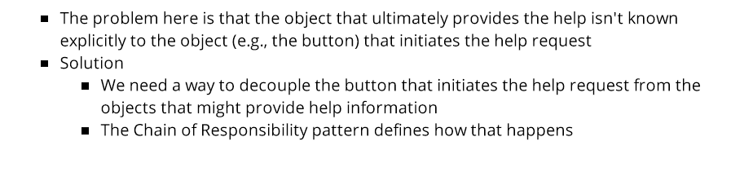
Chain of Responsibility
Motivation

Slide 4
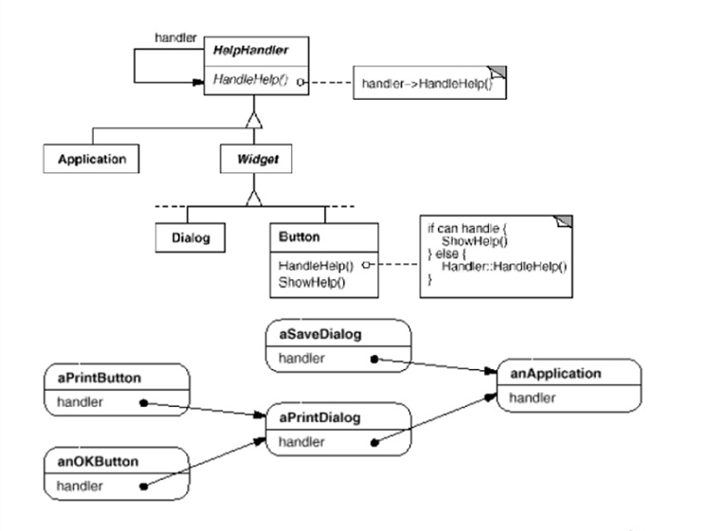

Slide 5
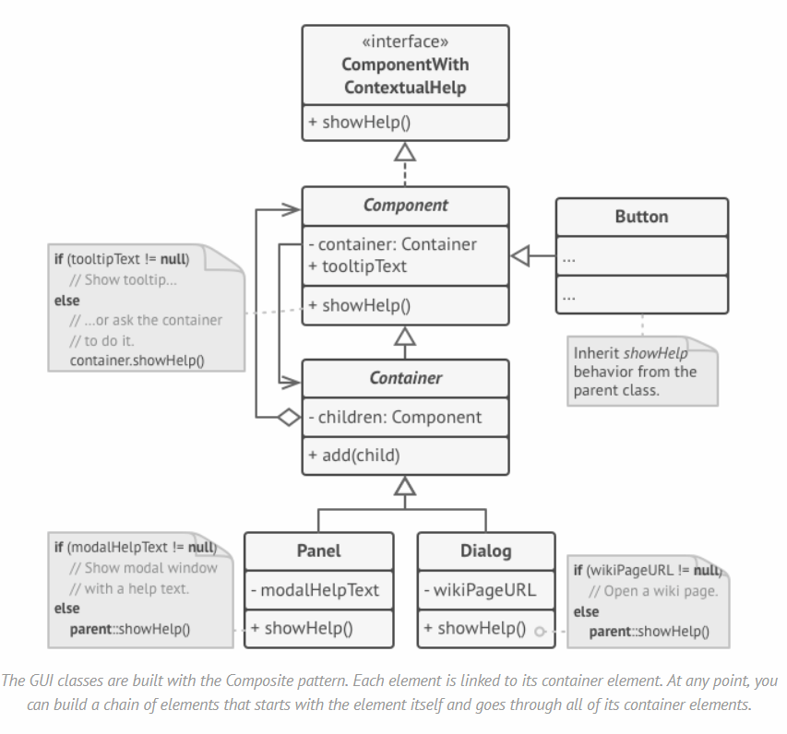

Slide 6
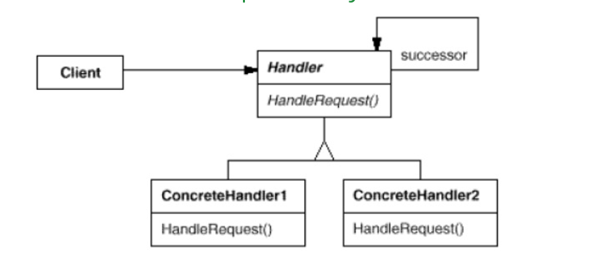
Chain of Responsibility
Structure

Slide 7
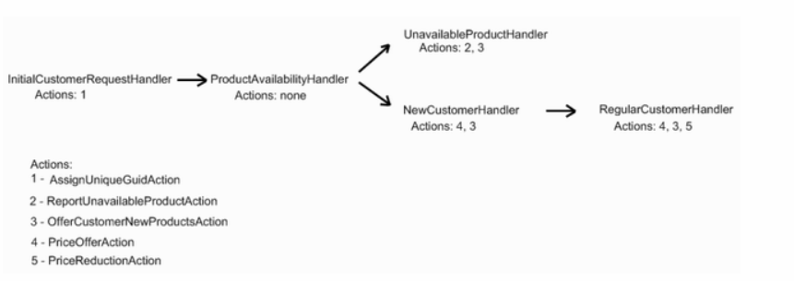
Chain of Responsibility
Variatie: Tree of Responsibility

Slide 8
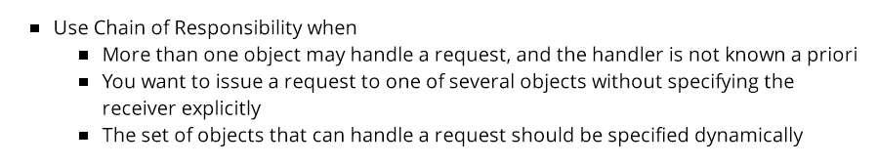
Chain of Responsibility
Applicability

Slide 9
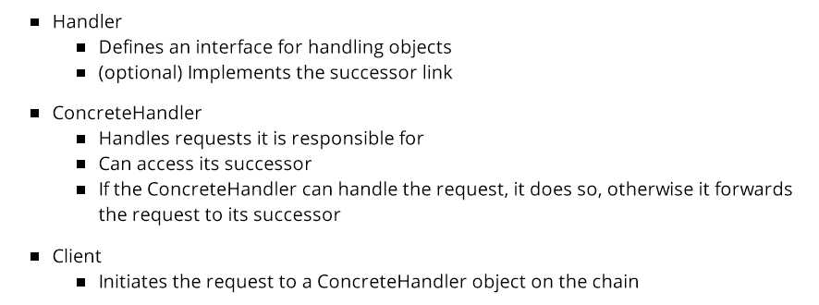
Chain of Responsibility
Participants

Slide 10

Chain of Responsibility
Collaboration

Slide 11
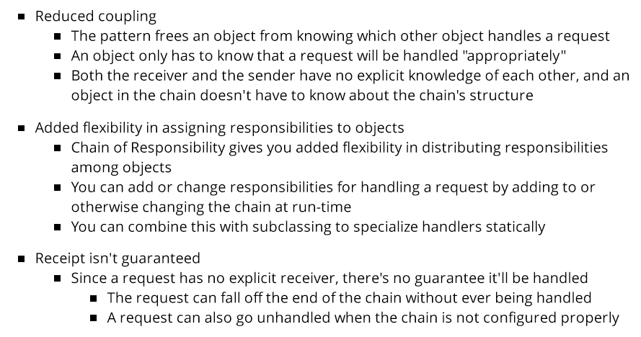
Chain of Responsibility
Consequences

Slide 12
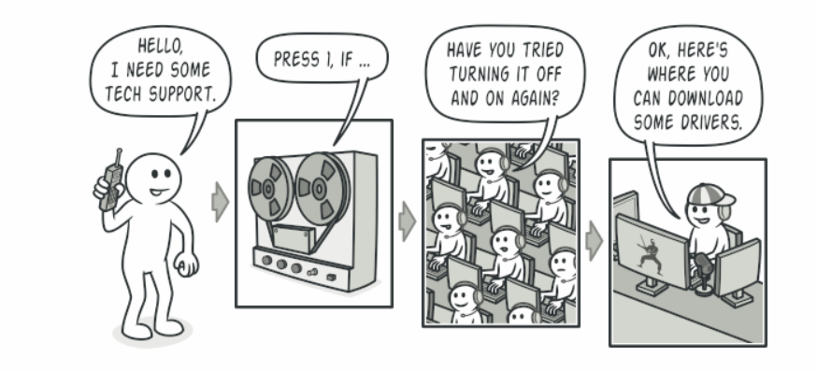
Chain of Responsibility
Real world analogy

Slide 13
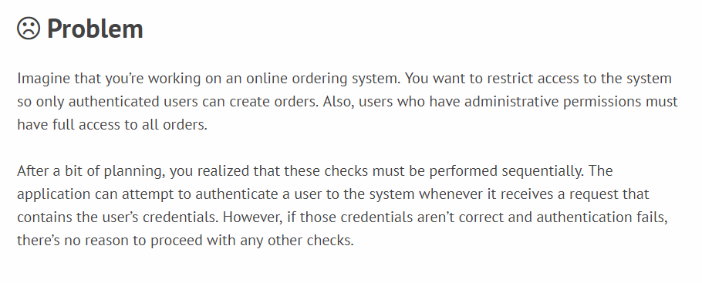
Chain of Responsibility
Problem: Online Webshop

Slide 14
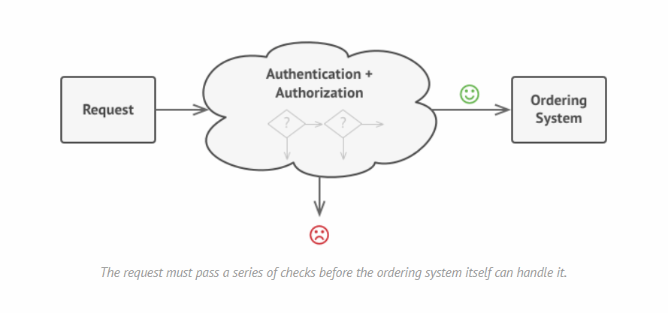
Chain of Responsibility
Problem: Online Webshop

Slide 15
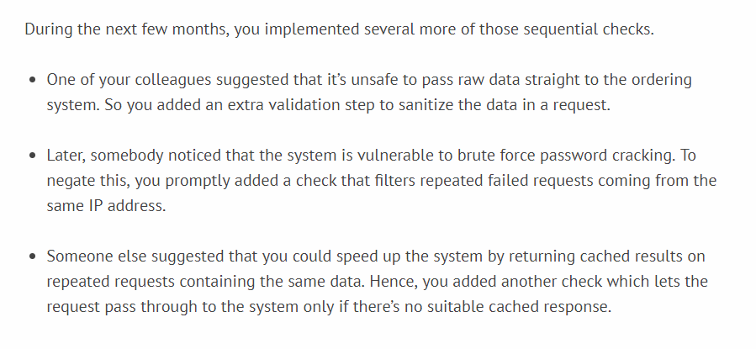
Chain of Responsibility
Problem: Online Webshop

Slide 16
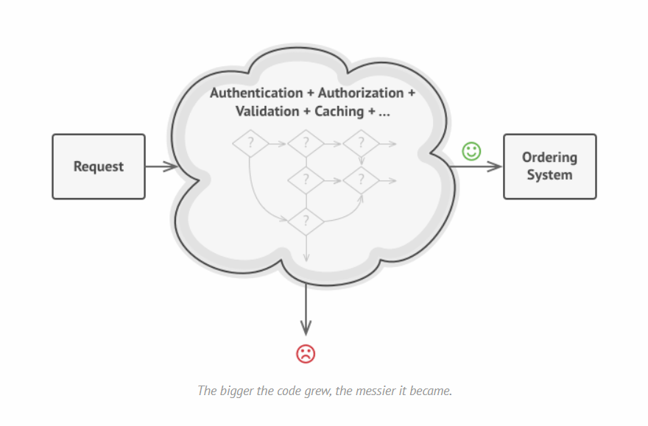
Chain of Responsibility
Problem: Online Webshop

Slide 17
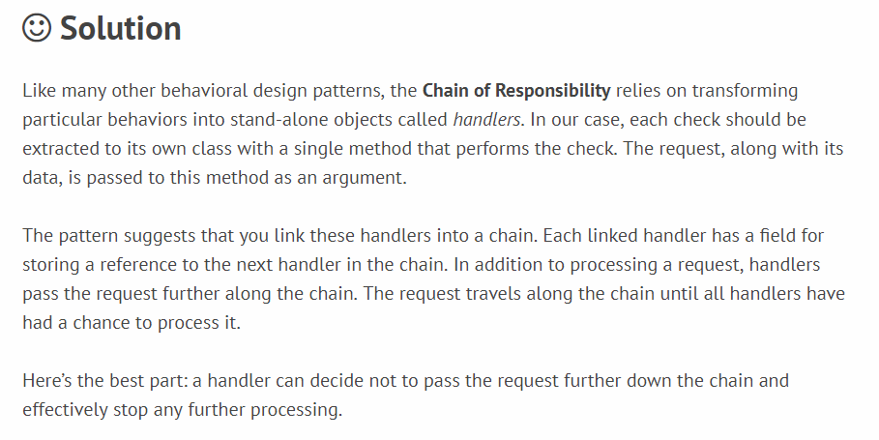
Chain of Responsibility
Problem: Online Webshop

Slide 18
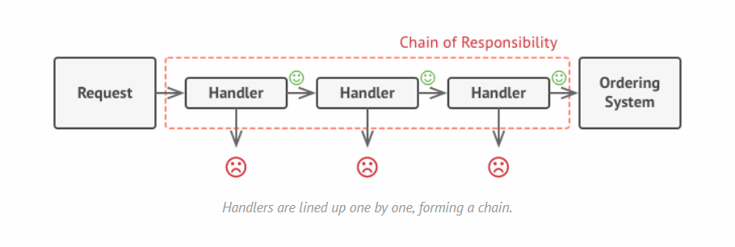
Chain of Responsibility
Problem: Online Webshop

Slide 19
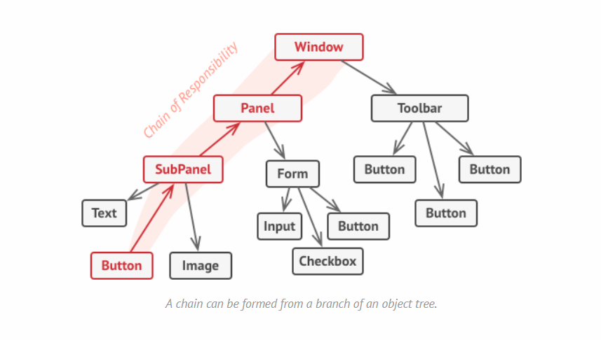
Chain of Responsibility
Problem: Online Webshop

Slide 20
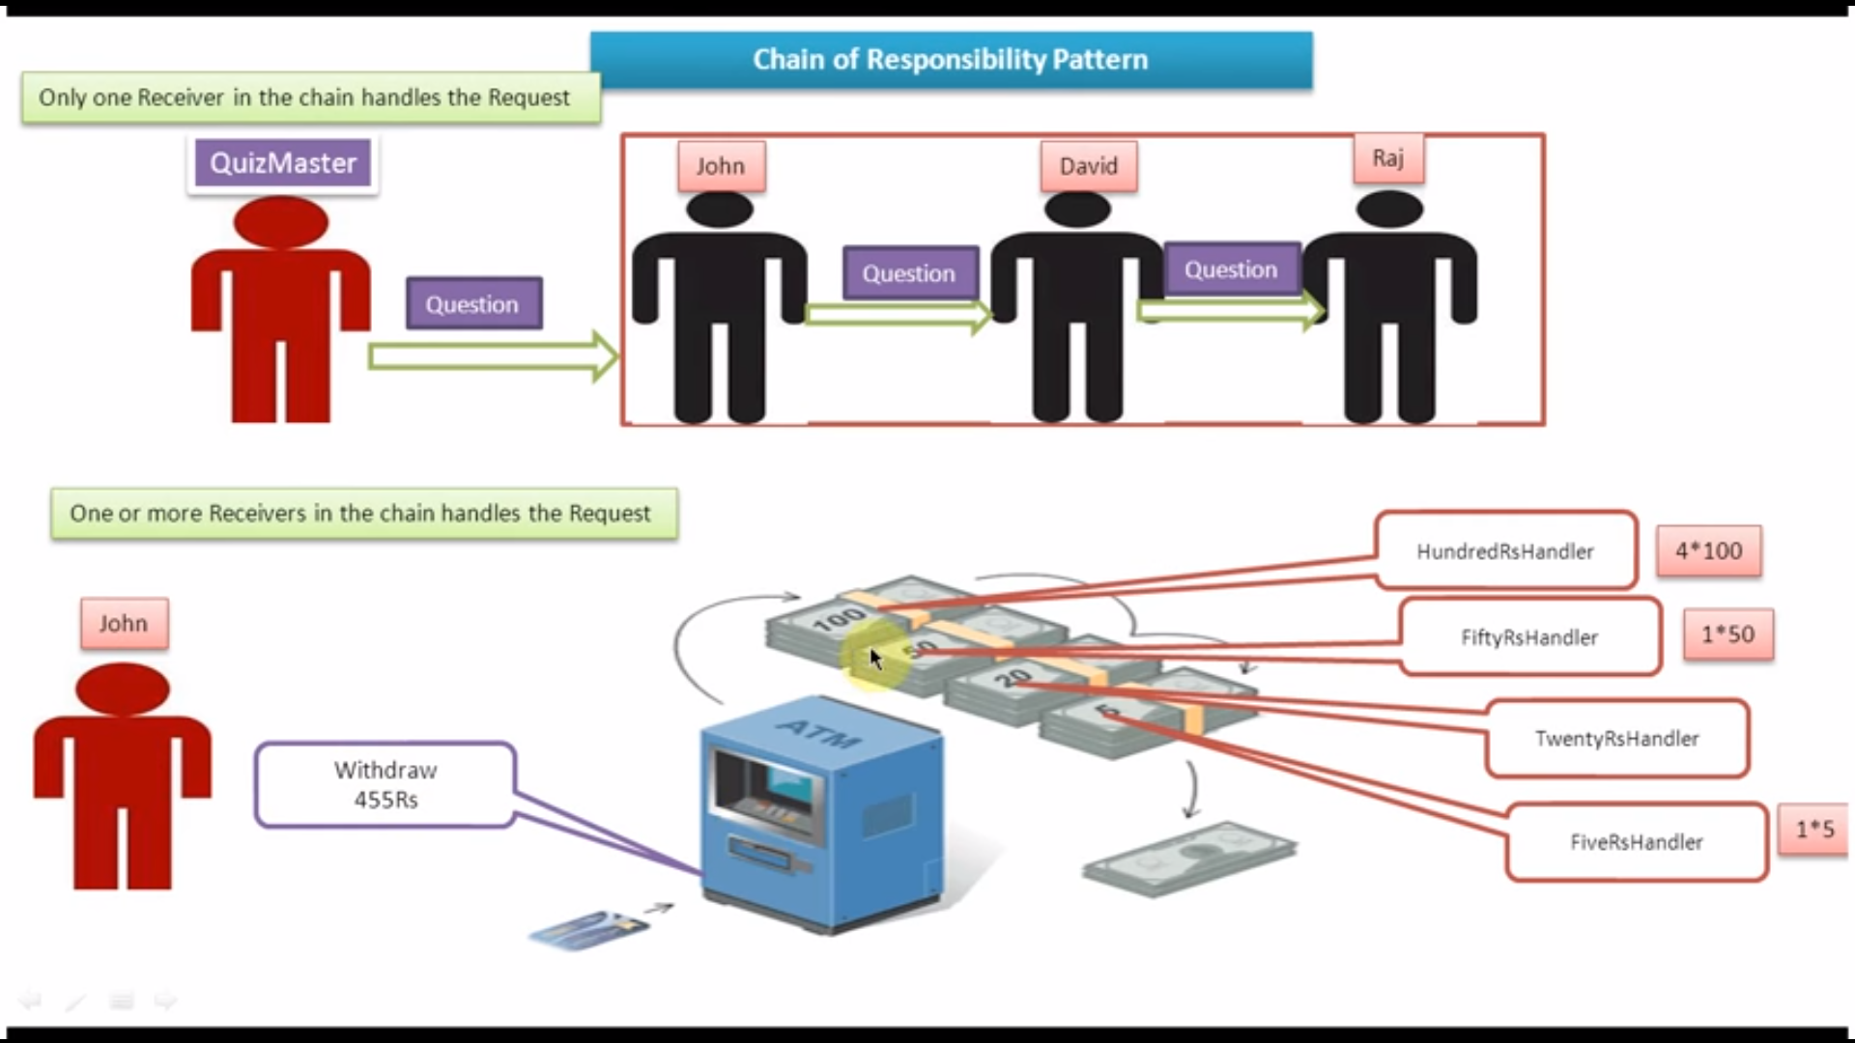
Chain of Responsibility
Code

Slide 21
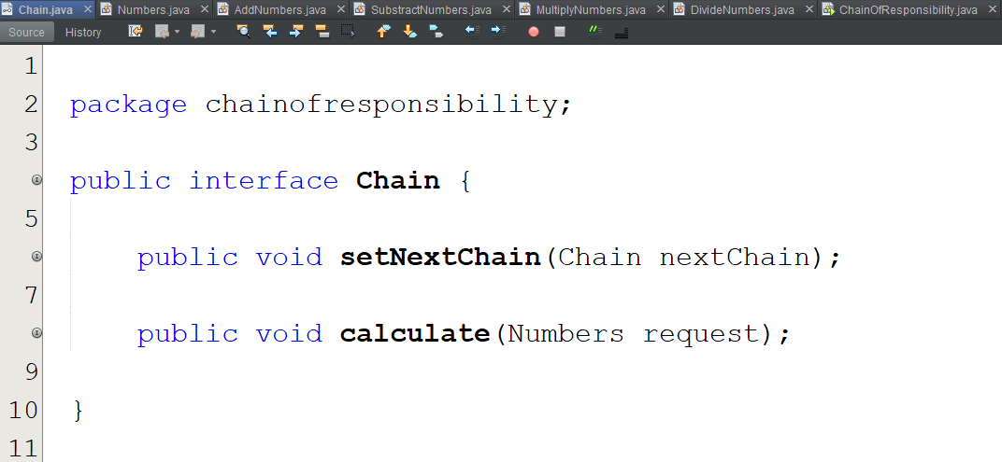
Chain of Responsibility
Code: Add, Substract, Multiply, Divide

Slide 22
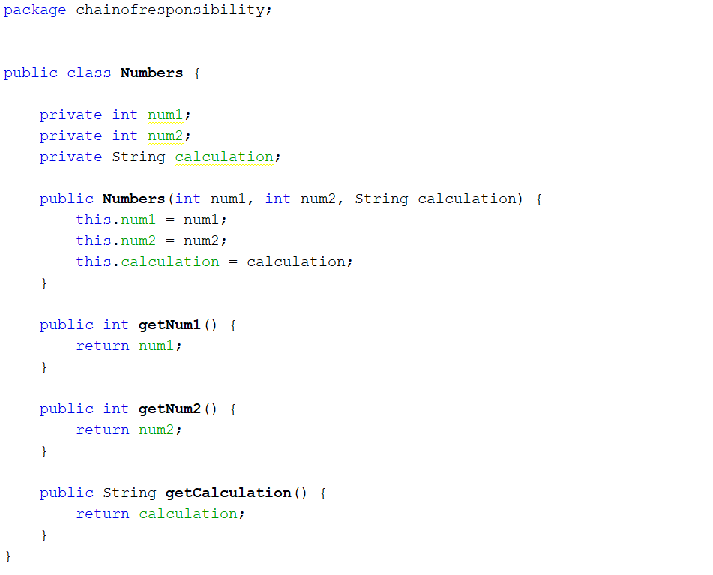

Slide 23
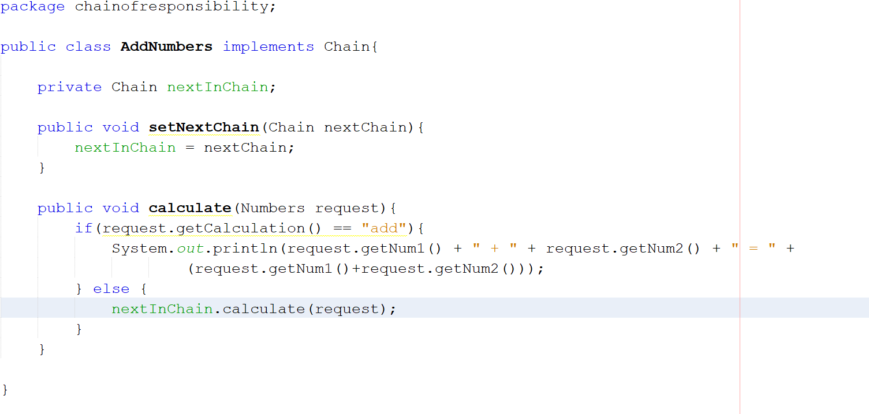

Slide 24
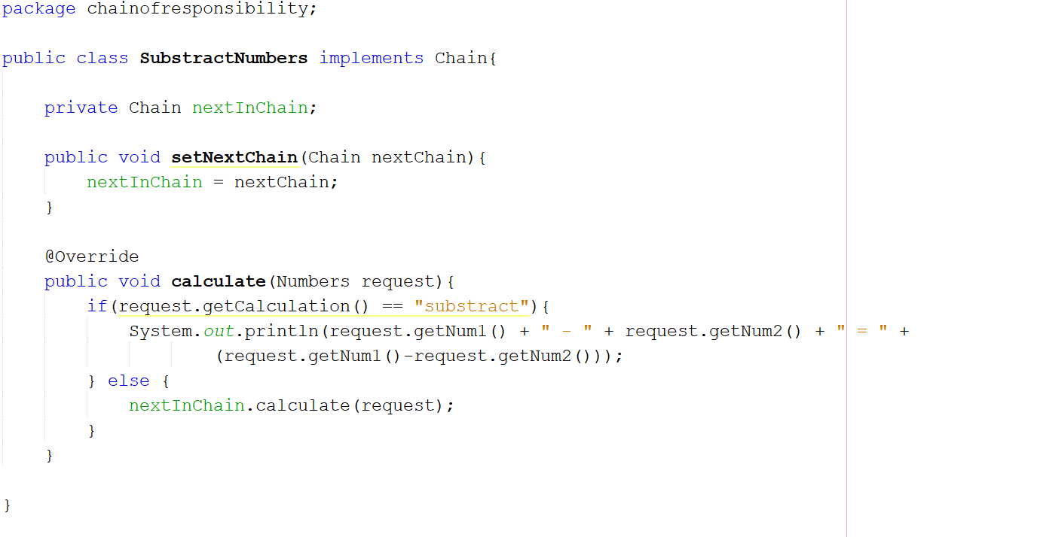

Slide 25
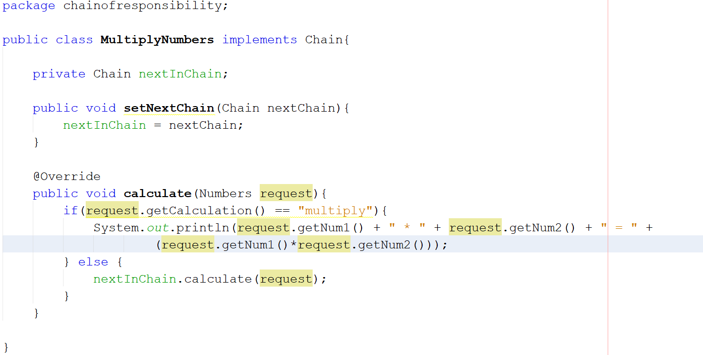

Slide 26
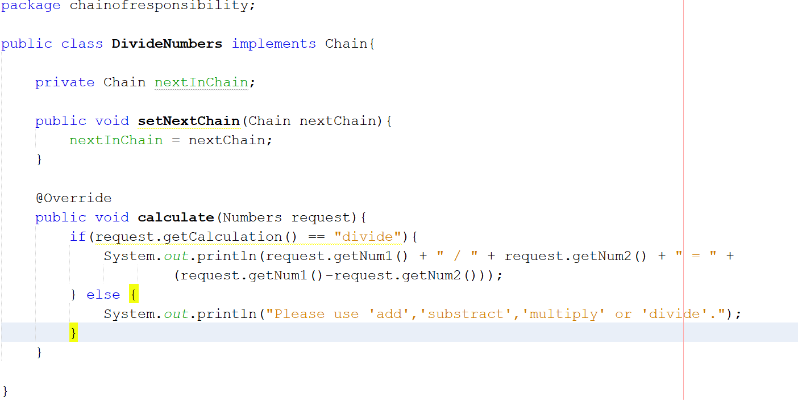

Slide 27
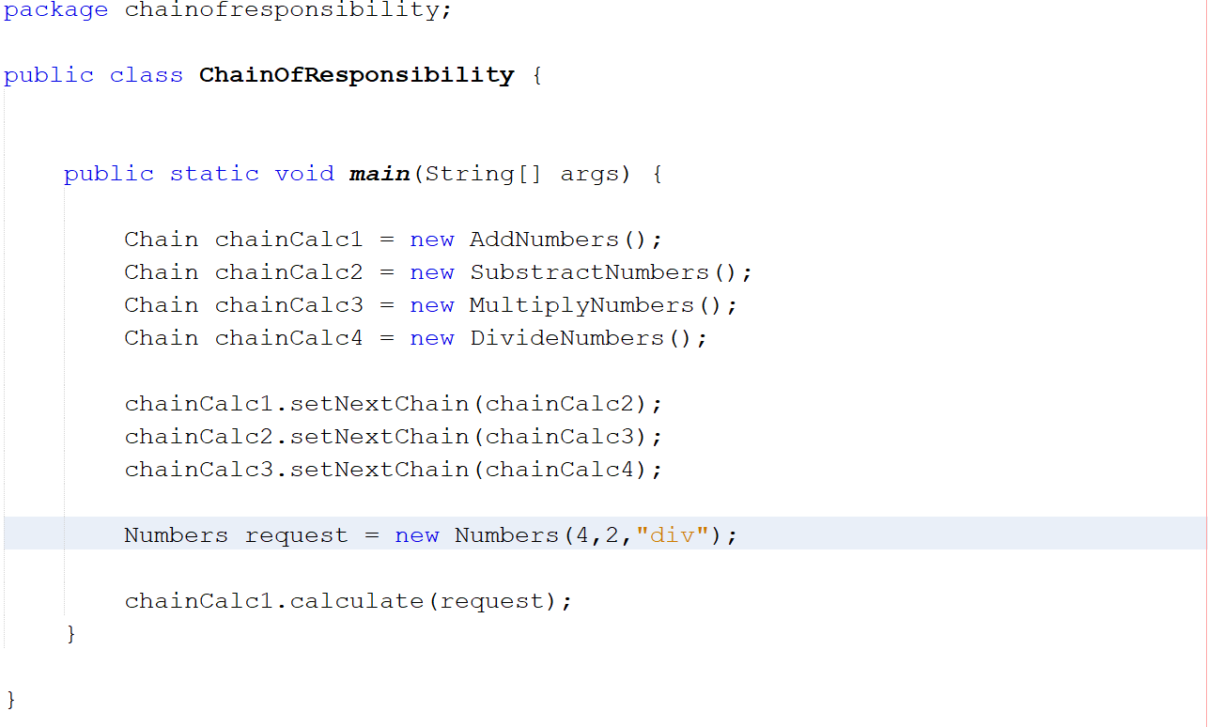

Slide 28
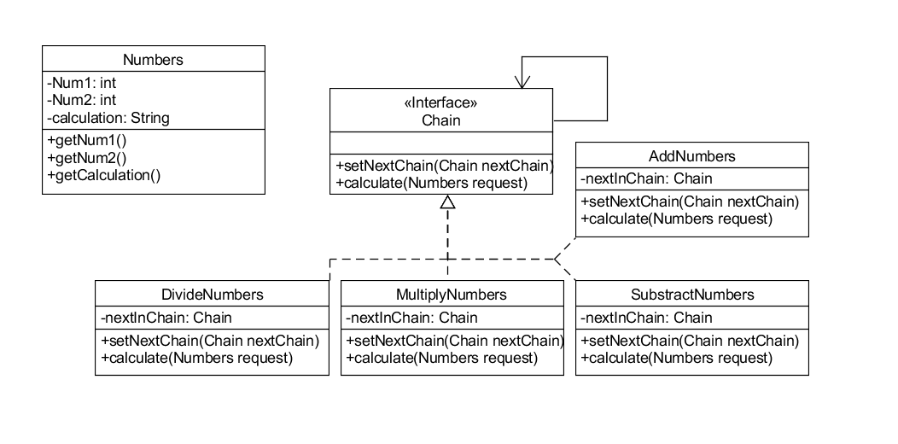
Chain of Responsibility
Code: Class Diagram

Slide 29
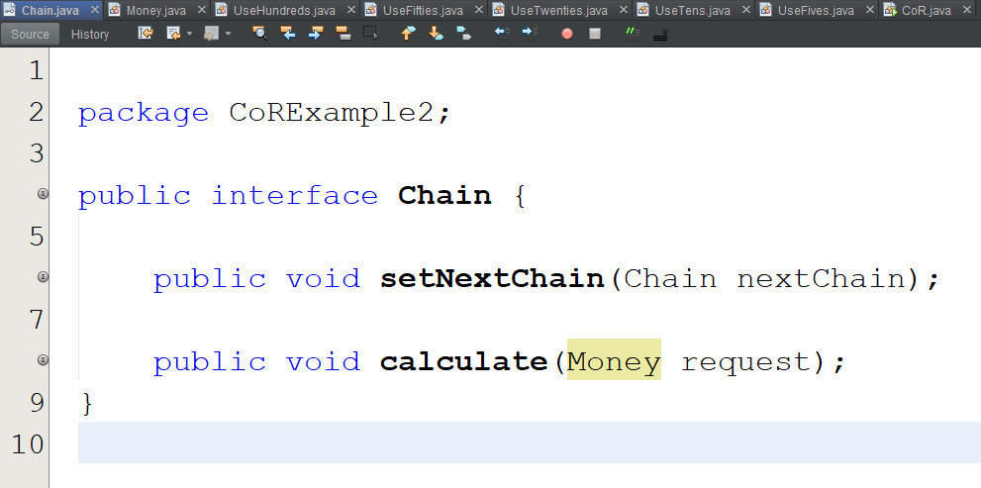
Chain of Responsibility
Code: Bankautomaat

Slide 30
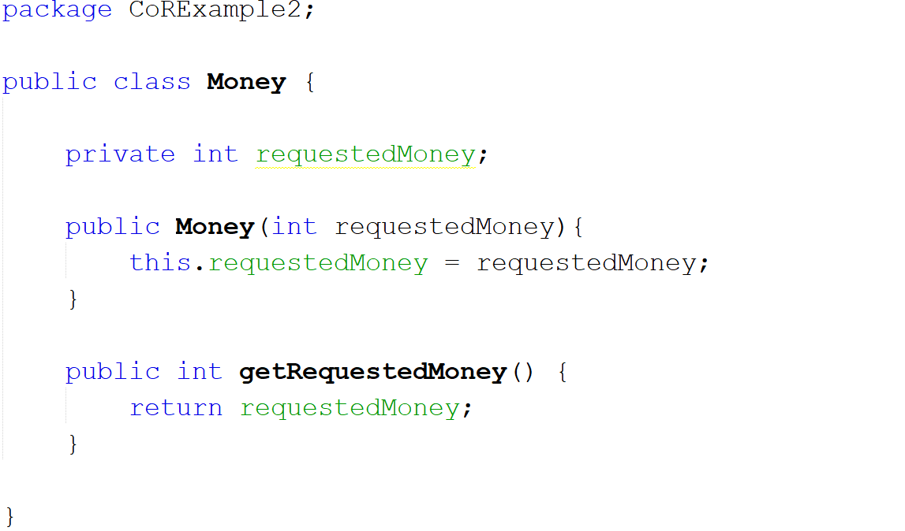

Slide 31
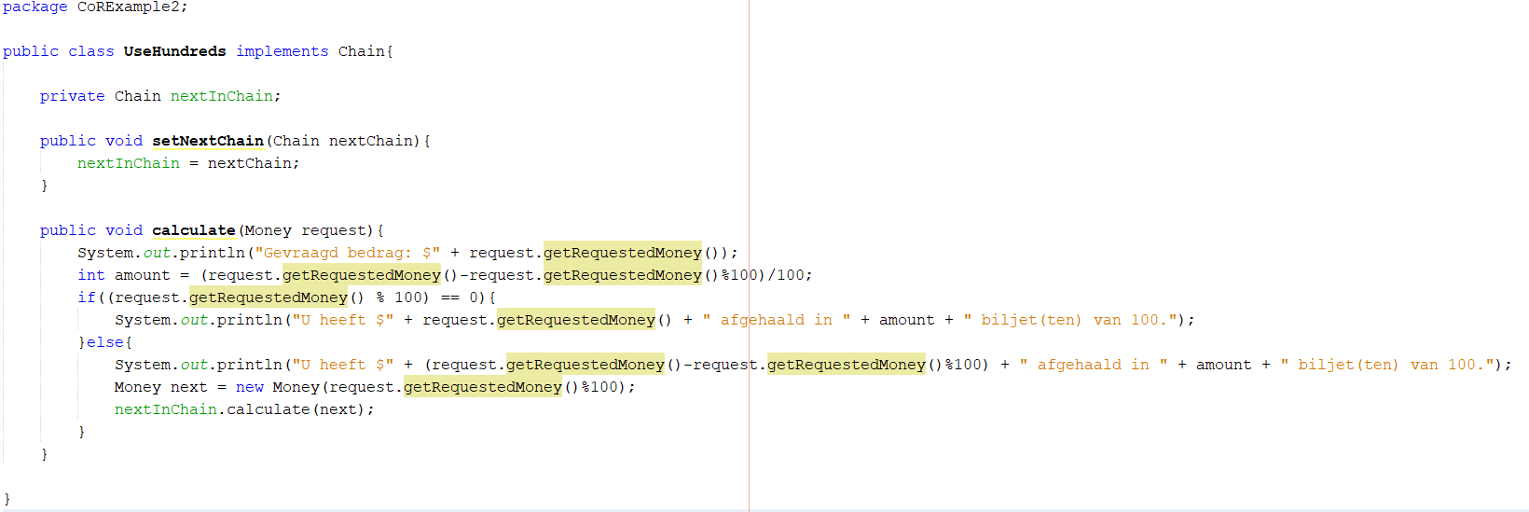

Slide 32
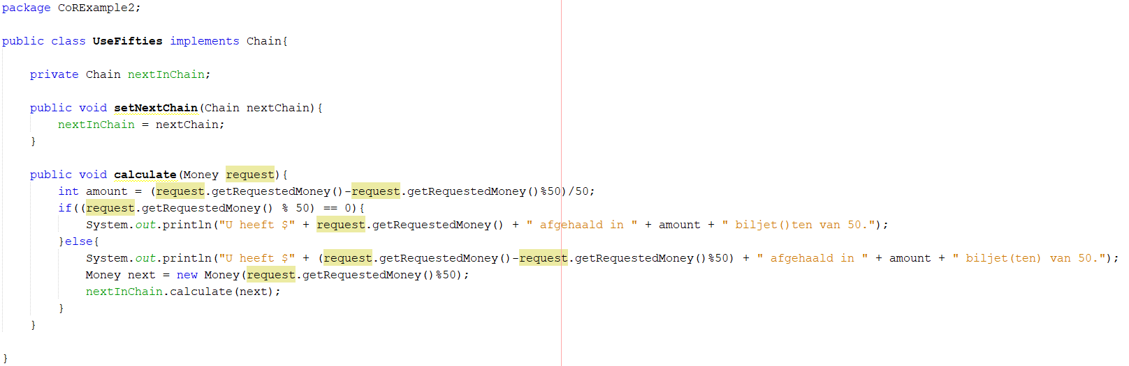

Slide 33
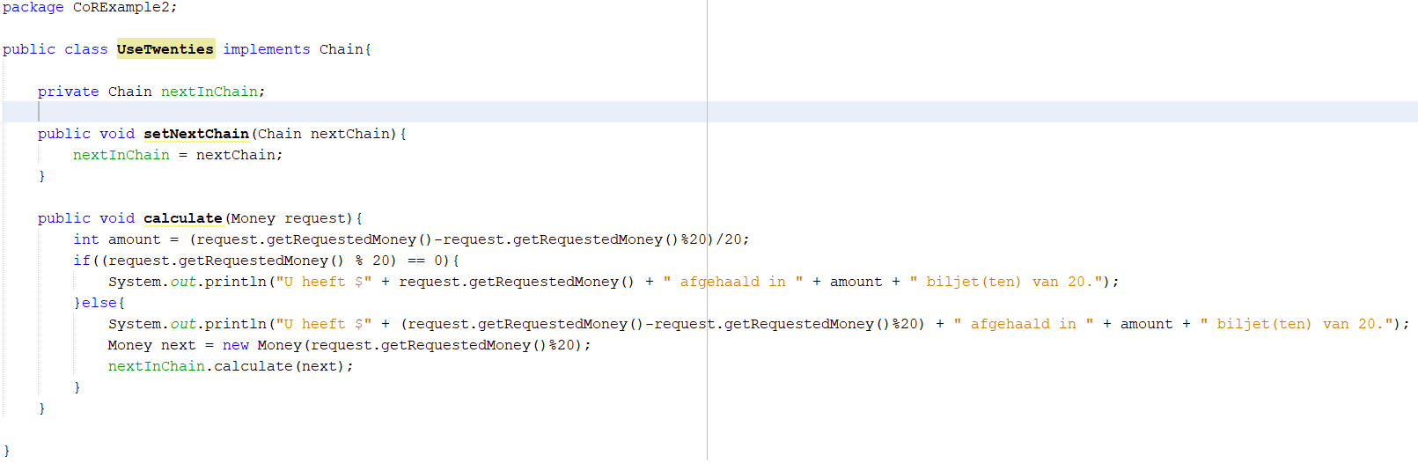

Slide 34
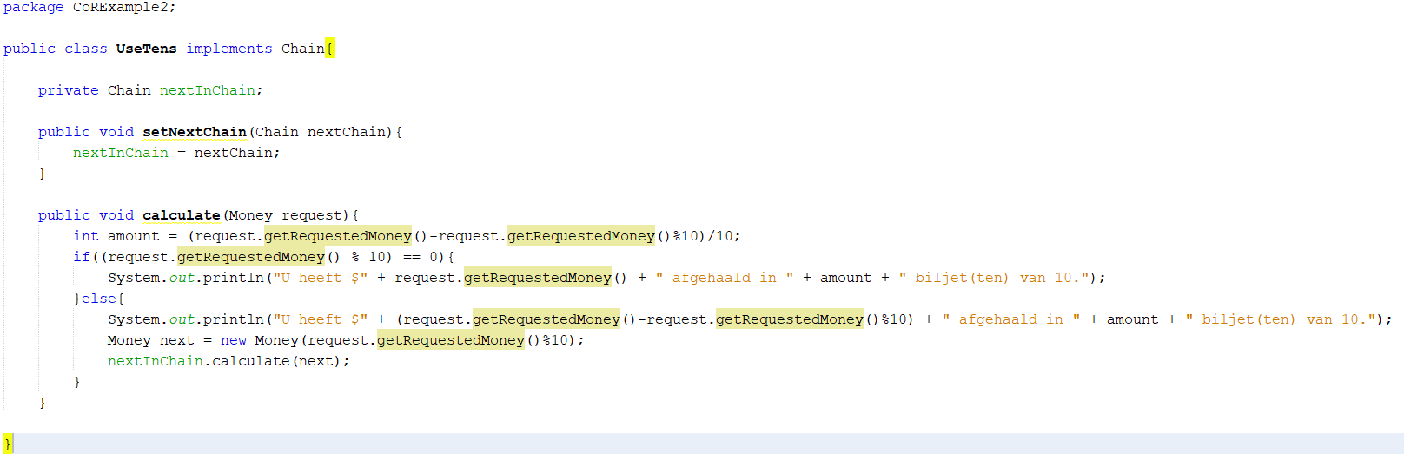

Slide 35
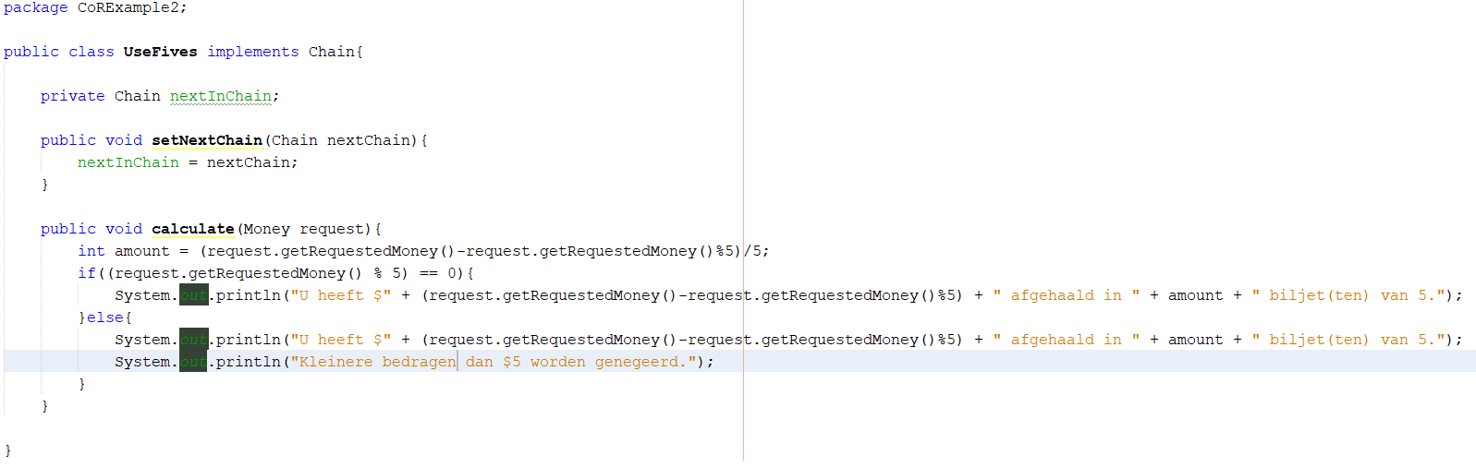

Slide 36
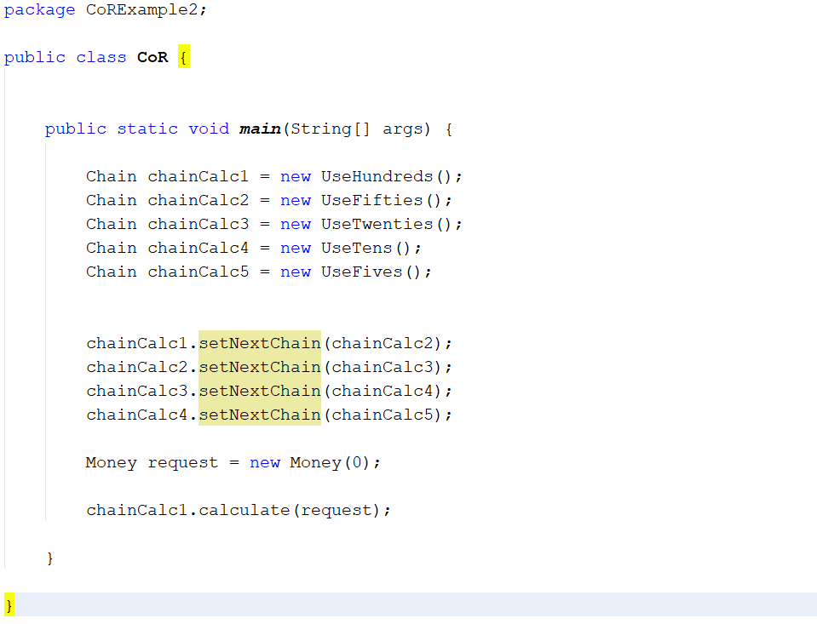

Slide 37
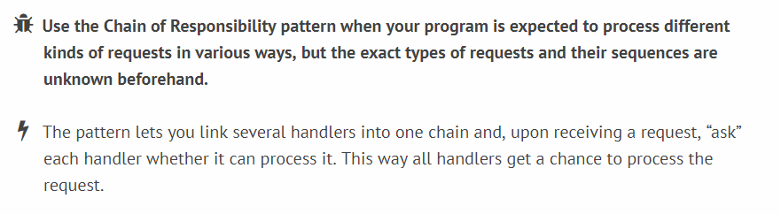
Chain of Responsibility
Recap

Slide 38
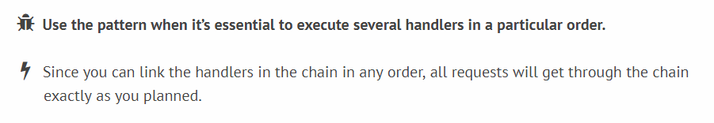
Chain of Responsibility
Recap

Slide 39
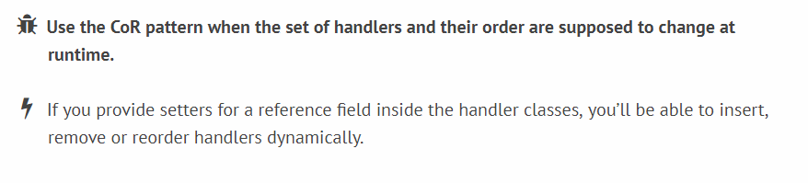
Chain of Responsibility
Recap

Slide 40
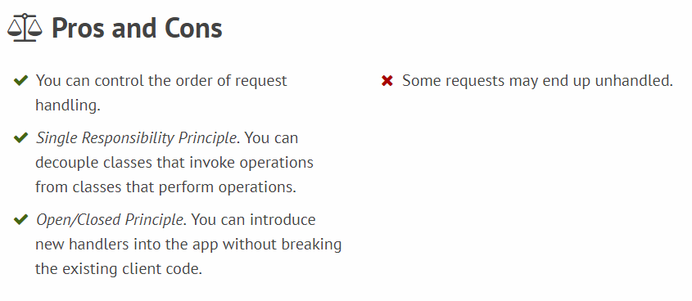
Chain of Responsibility
Recap

Slide 41
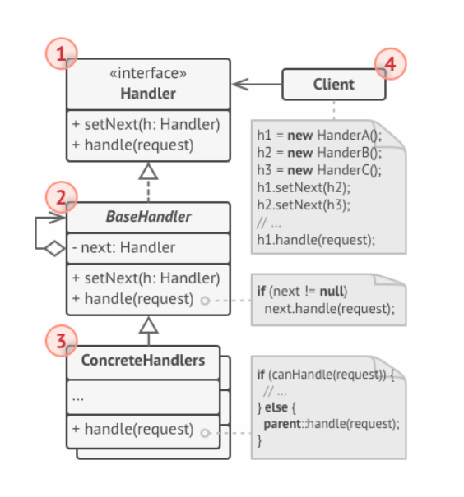
Chain of Responsibility
Recap

